Slide 1
Los Angeles
New York
The Collective Wisdom in Managing Public Pension Assets
Stephen L Nesbitt, CEO, Cliffwater LLC
Testimony before the Public Pension Management & Asset Investment Review Commission (PPMAIRC)
October 25, 2018

Slide 2
1. The Inconvenient Truth in Public Pensions
Pension Performance, Actuarial Rates, and Funding Ratios
17 Fiscal Years ending June 30, 2017
4.00
3.50
$3.58
Index Values (June 30, 2000 = 1.00)
3.00
State Pension Actuarial Interest Rate
2.50
=7.79%
$2.56
2.00
State Pension Investment Return
=5.69%
1.50
1.00
State Pension Funding Ratio
=71%
0.71
0.50
June 30,
Source: State Retirement System CAFRs, Cliffwater LLC calculations

Slide 3
2. Asset Allocation
Best practices
Set long-term target asset class weights; resist change
Diversify, diversify, diversify
Don’t market-time, rebalance
Revisit every 3-5 years
Industry experience
Most public pensions “cluster” with similar allocations
General consensus on methodology and assumptions
A few “allocators” drive the process
Liabilities ignored
Different risk levels across DC, public DB, endowments

Slide 4
3. State Pension Return & Risk, FY2001 to FY2017
10.0%
9.0%
8.0%
7.89% Weighted Average Actuarial Rate
FY2001-2017 Annualized Investment Return
7.0%
6.0%
5.0%
U.S. Bonds (Barclays Aggregate)
Global Stocks (MSCI ACWI)
4.0%
3.0%
2.0%
Legend
state pension plan
1.0%
0.0%
Source: Cliffwater LLC, Bloomberg Barclays Aggregate, MSCI ACWI
Risk (Standard Deviation)

Slide 5
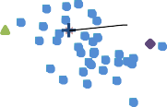
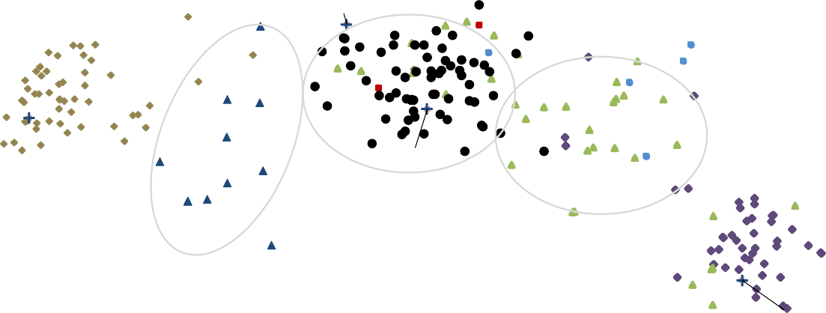
4. State Pension Asset Class Return & Risk 10 Fiscal Years ending FY2017
13.00%
Legend
Black = Total Fund
Brown = Fixed Income Red = Private Equity Dark Blue = Hedge Funds Green = Real Estate
Blue = US Equity
Purple = Non-US Equity
11.00%
10 Year Annualized Return ending June 30, 2017
9.00%
C|A Private Equity
7.00%
NCREIF Property Index
Russell 3000 Index
5.00%
BB Aggregate Bond Index
70/30 Mix
3.00%
1.00%
Treasury Bills
HFRI Fund of Funds Index
Non-US Stocks (ACWI ex US)
0.00%
5.00%
10.00%
15.00%
20.00%
-1.00%
Standard Deviation of Annual Fiscal Year Returns

Slide 6
5. State Pension Asset Class Return & Risk 10 Fiscal Years ending FY2017 (continued)
13.00%
11.00%
10 Year Annualized Return ending June 30, 2017
9.00%
Private Equity
C|A Private Equity
Russell 3000 Index
7.00%
US Equities
NCREIF (NPI)
5.00%
Fixed Income
Total Fund
Bloomberg Barclays Aggregate
70% Stock/30% Bond
Real Estate
Absolute Return
3.00%
Non‐US Equities
1.00%
HFRI Fund of Funds Index
MSCI ACWI ex US
T‐bill
0.00%
5.00%
10.00%
15.00%
20.00%
-1.00%
Standard Deviation of Annual Fiscal Year Returns

Slide 7
6. State Pension Private Equity Performance 16 Fiscal Years ending FY2017
Private Equity Performance among State Penson Funds
Covering 16 Years ending June 30, 2017 Growth of $1.00
$9.00
State11 14.3%
State18 13.0%
$8.00
State21 12.9%
State12 12.3%
$7.00
State13 11.4%
State3 11.3%
State9 11.2%
$6.00
State19 10.9%
State8 10.7%
Growth of $1.00
$5.00
State5 10.1%
State16 10.4%
State15 9.9%
$4.00
State10 9.9%
State17 9.6%
State20 9.7%
$3.00
State1 9.5%
State14 9.2%
$2.00
State7 8.7%
State 2 8.7%
State 4 8.1%
$1.00
21 State Composite*
10.7%
Public Equity Benchmark** 6.6%
$0.00
Fiscal Years ending June 30
* An equal‐weighted average of all 20 state funds who reported private equity returns in annual CAFRs for June 30 fiscal years 2002‐2017.
** A public equity benchmark weighted 70% to the Russell 3000 Index (6.8% annualized return) and 30% to the MSCI ACWI ex US Index (5.9% annualized return), with assigned weights reflecting Cliffwater's judgement of the US and non‐US content of a diversified private equity portfolio.

Slide 8
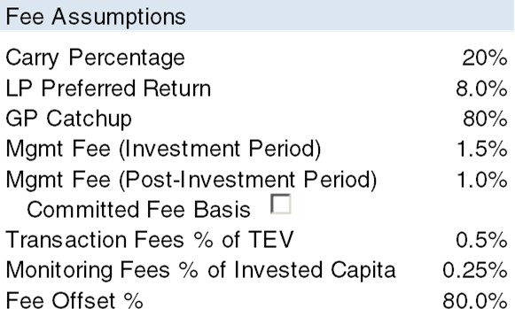
7. Private Equity Fees & Gross-of-Fee Performance
PE Total Fees % of Assets
Fund Assumptions
Total Commitments ($m) | $1,000
Investment Period (yrs) | 5
Fund Life (yrs) | 10
Max % Funded | 90%
Expected Return | 15%
Standard Deviation | 9%
Investment Assumptions
Avg. Holding Period | 5
Average IRR | 20.0%
 | 5.0%
 | 4.0%
 |  | Performance fees
 |  | (carried interest)
Fees based on "committed " capital create higher private | 3.0% | increases total fee as gross return increases above th preferred return.
equity costs. | 2.0%
 |  | The "preferred
 |  | return" offered by
 | 1.0% | private equity keeps fees down at single
 |  | digit returns.
 | 0.0%
Total Fees as % of Invested Assets
s
Implied TVPI
2.49x
e
-30%
-20%
-10% 0%
10%
20%
30%
Gross of Fee Return or IRR
Expected private equity fee = 3.73% of net assets, 25% of gross profits

